Slide 1

PowerEnJoy Design document
Alessandro Caprarelli, Roberta Iero, Giorgio De Luca

Slide 2
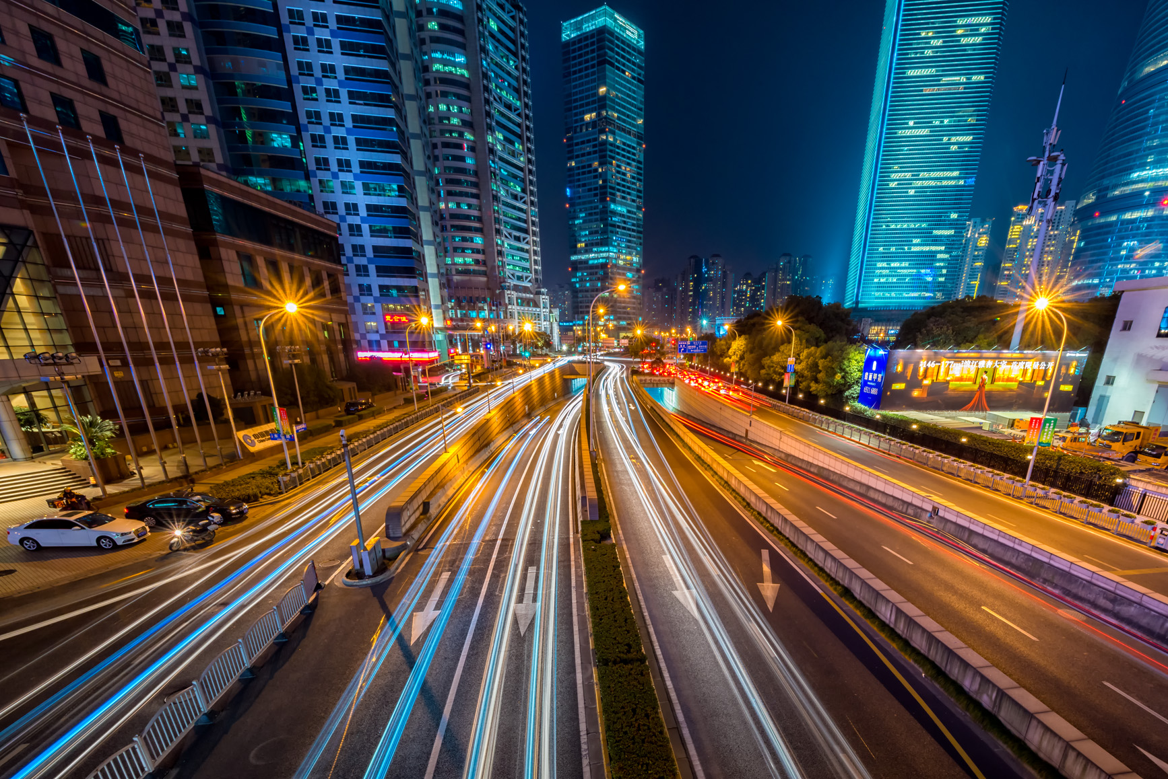
Table of content
Architectural design 3
Algorithm design 7
User interfaces 11
Notes:
This document describes:
◆ goals
◆ components of the system
◆ functional and non-functional requirements
◆ domain properties and assumptions
It Also provides a description of the system using UML diagrams.

Slide 3
Architectural design
Architectural design 3
High level view
Component view
Deployment view
Algorithm design 7
User interfaces 11
Notes:
This document describes:
◆ goals
◆ components of the system
◆ functional and non-functional requirements
◆ domain properties and assumptions
It Also provides a description of the system using UML diagrams.

Slide 4
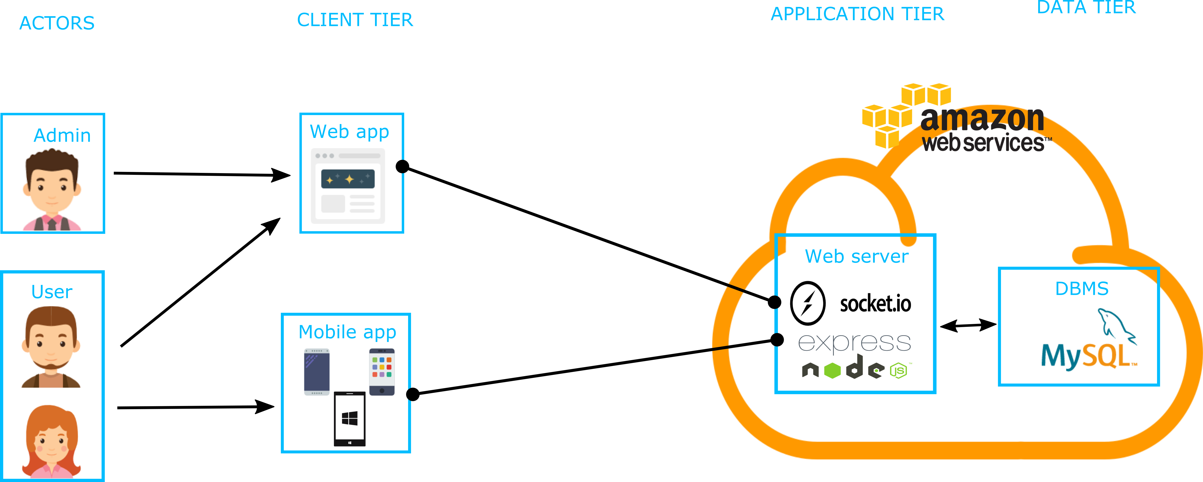
High level view
Notes:
User could be: guest and registered client

Slide 5
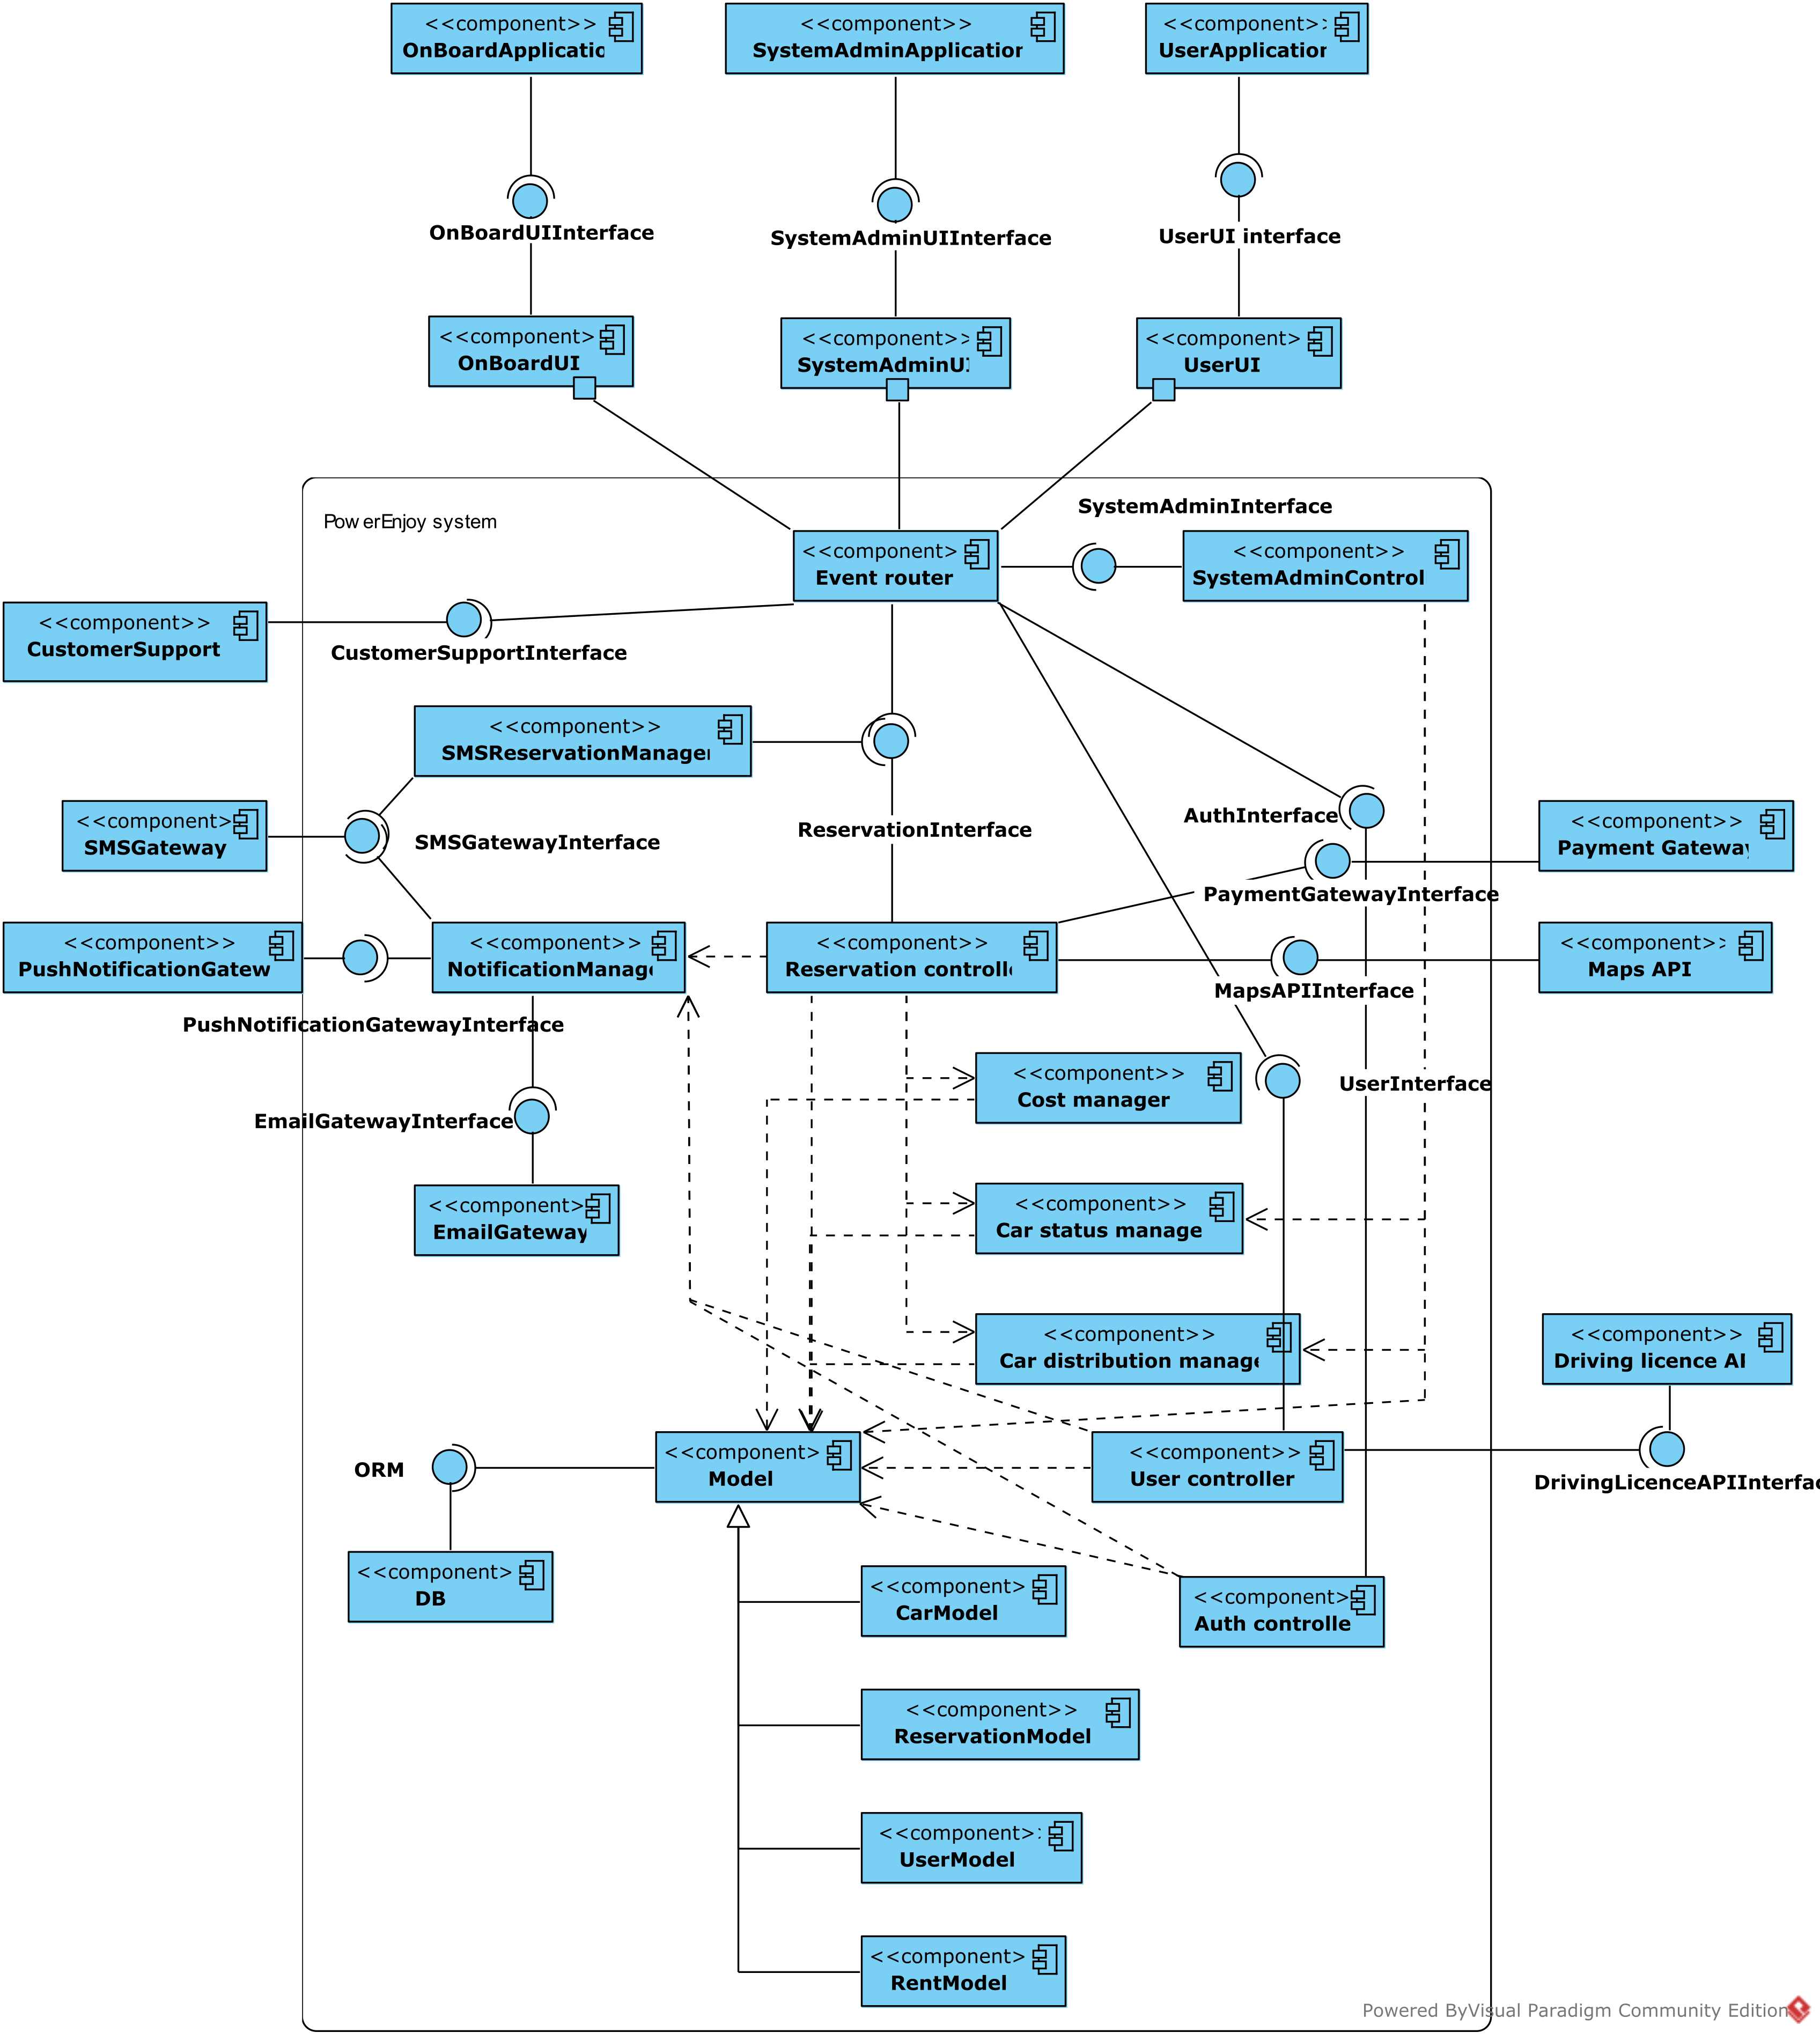
Component view
Main components:
Event router
AuthController
UserController
SystemAdminController
ReservationController
External components:
PaymentGateway
Maps API
Driving licence API
SMSGateway
PushNotificationGateway
CustomerSupport

Slide 6
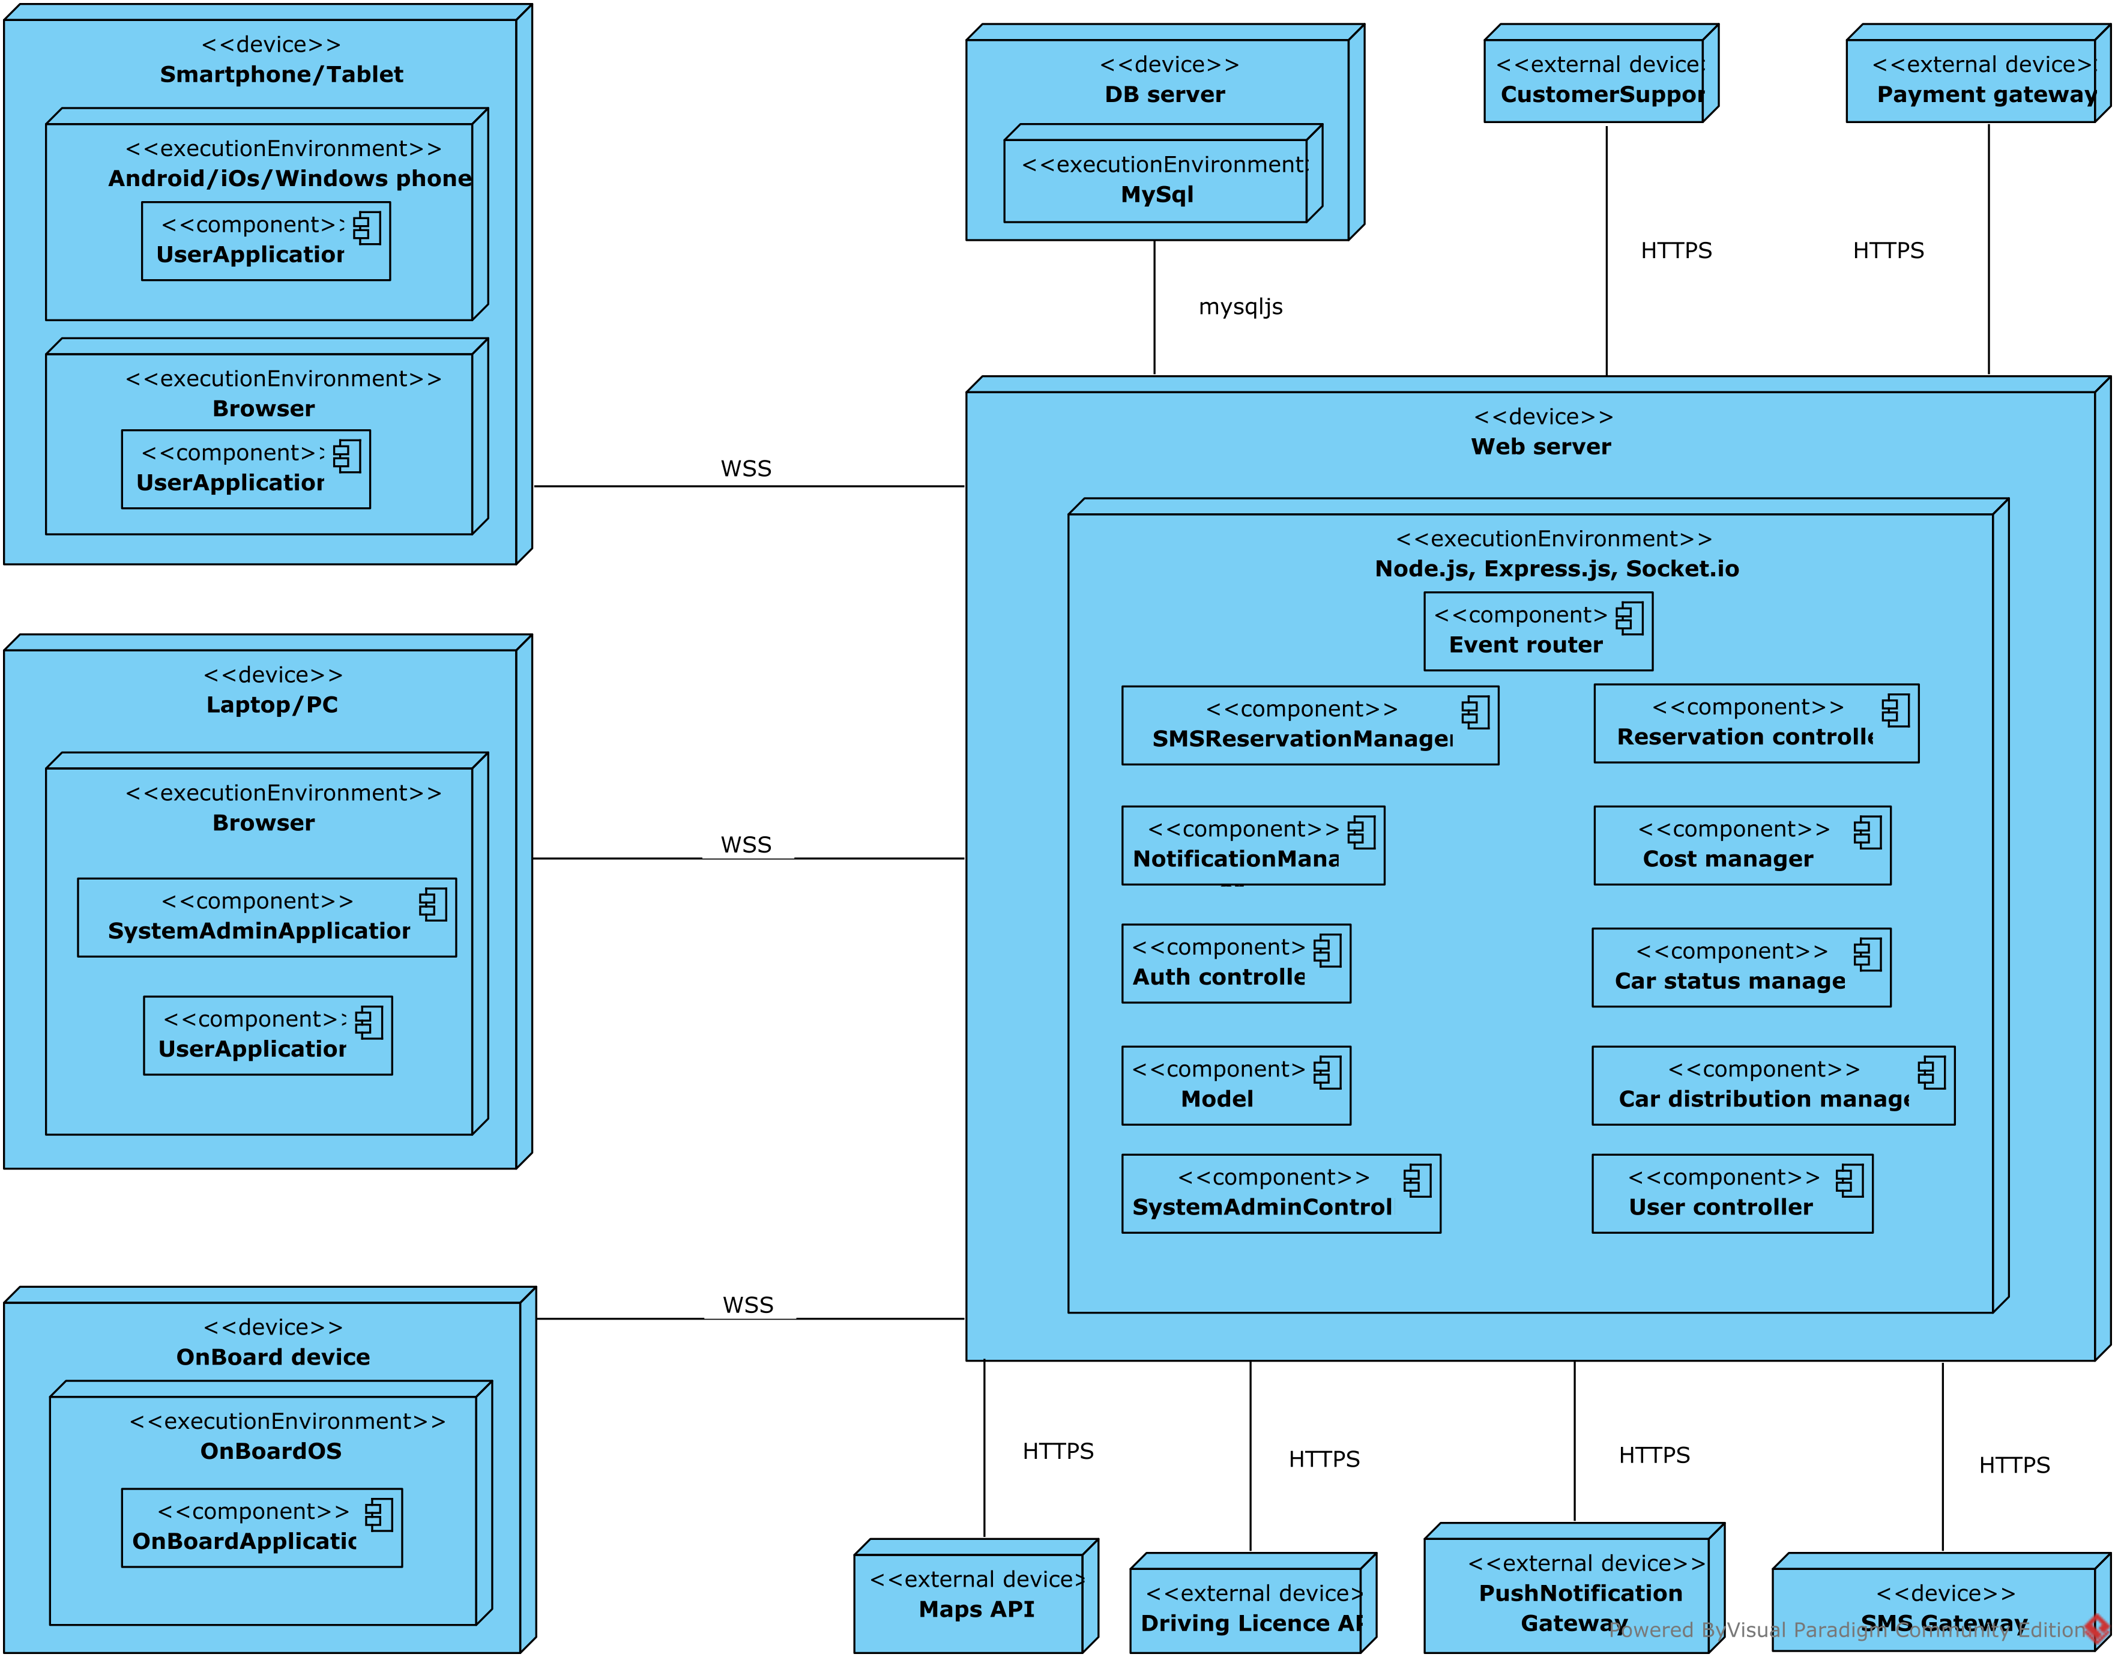
Deployment view

Slide 7
Algorithm design
Architectural design 3
Algorithm design 7
getCarsListInARange
submitReservation
calculateDiscount
User interfaces 11
Notes:
This document describes:
◆ goals
◆ components of the system
◆ functional and non-functional requirements
◆ domain properties and assumptions
It Also provides a description of the system using UML diagrams.

Slide 8
getCarsListInARange
START
END
OUTPUT
cars list
INPUT
user position
search range
YES
GET CARS IN RANGE
Car is rentable

Slide 9
submitReservation
START
CREATE RESERVATION AND
START COUNTDOWN
NO
User has already an active reservation
INPUT
user
car
YES
END

Slide 10
calculateDiscount
START
More than one people
YES
DISCOUNT +0.10
NO
INPUT
rent
car
Car plugged in
DISCOUNT – 0.30
YES
NO
YES
NO
Battery <= 20 %
AND
Distance from nearest SA > 3km
DISCOUNT –0.30
DISCOUNT ← 0
NO
Battery > 50%
DISCOUNT + 0.20
END
YES

Slide 11
User interfaces
Architectural design 3
Algorithm design 7
User interfaces 11
Client application
OnBoard application
UX diagram
Notes:
This document describes:
◆ goals
◆ components of the system
◆ functional and non-functional requirements
◆ domain properties and assumptions
It Also provides a description of the system using UML diagrams.

Slide 12
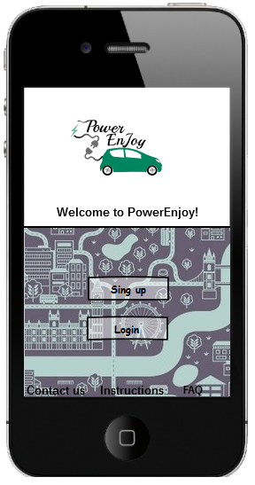
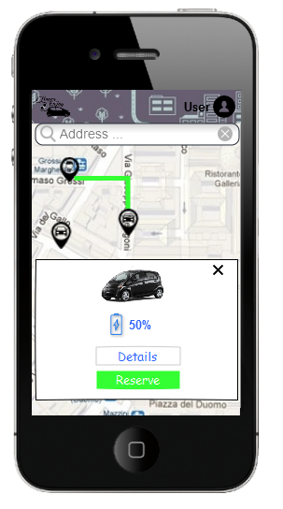
Client application

Slide 13
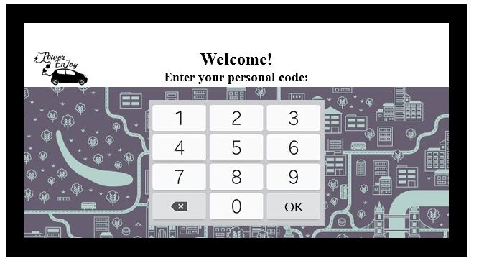
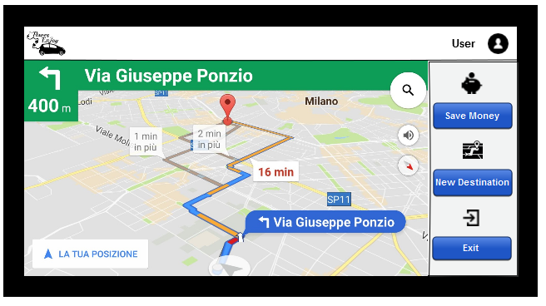
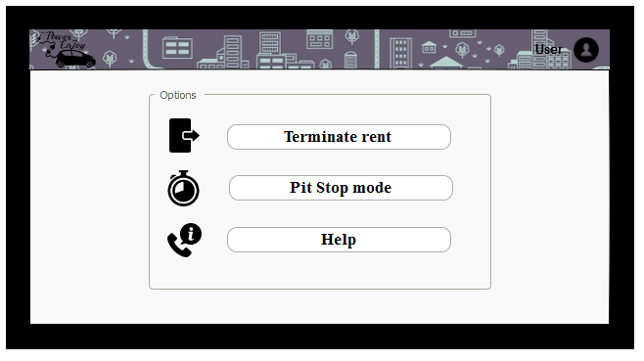
OnBoard application

Slide 14
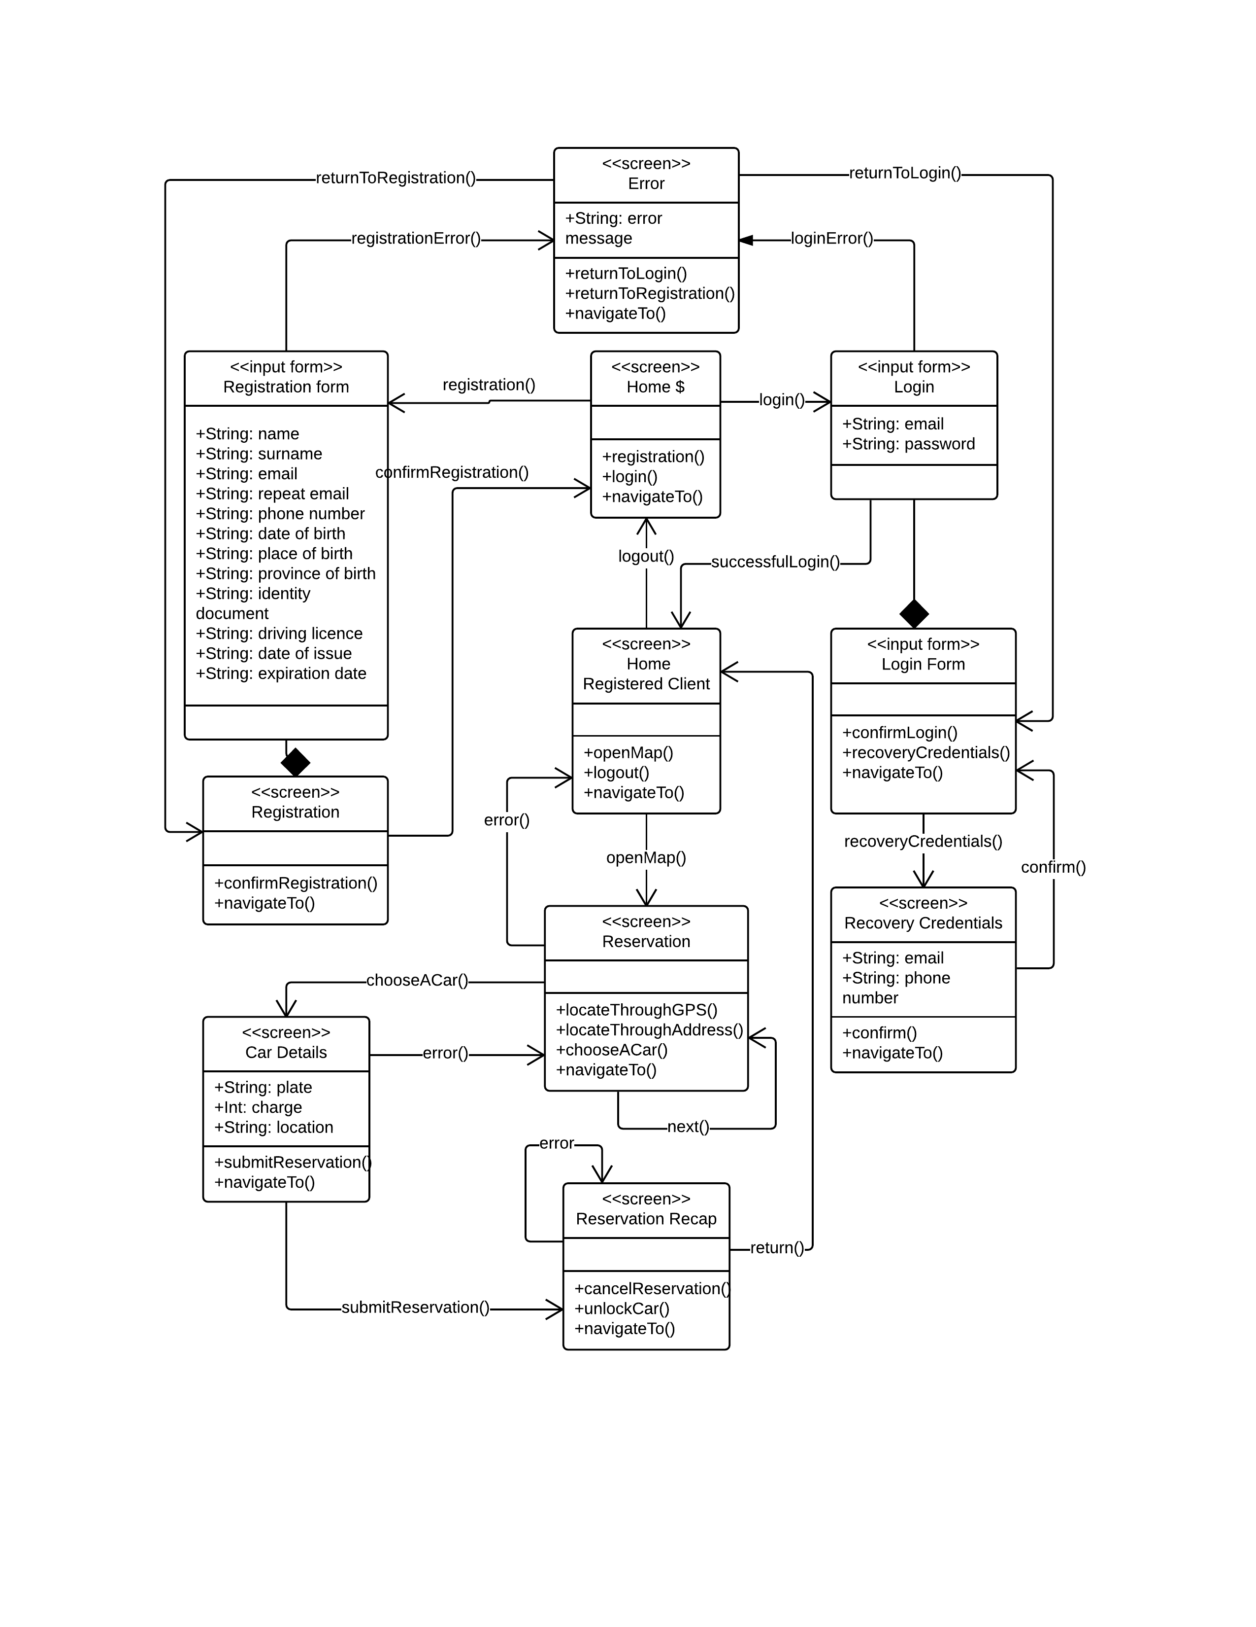
UX diagram

Slide 15
QUESTIONS?

